Slide 1

Broadcasting business … your business

Slide 2
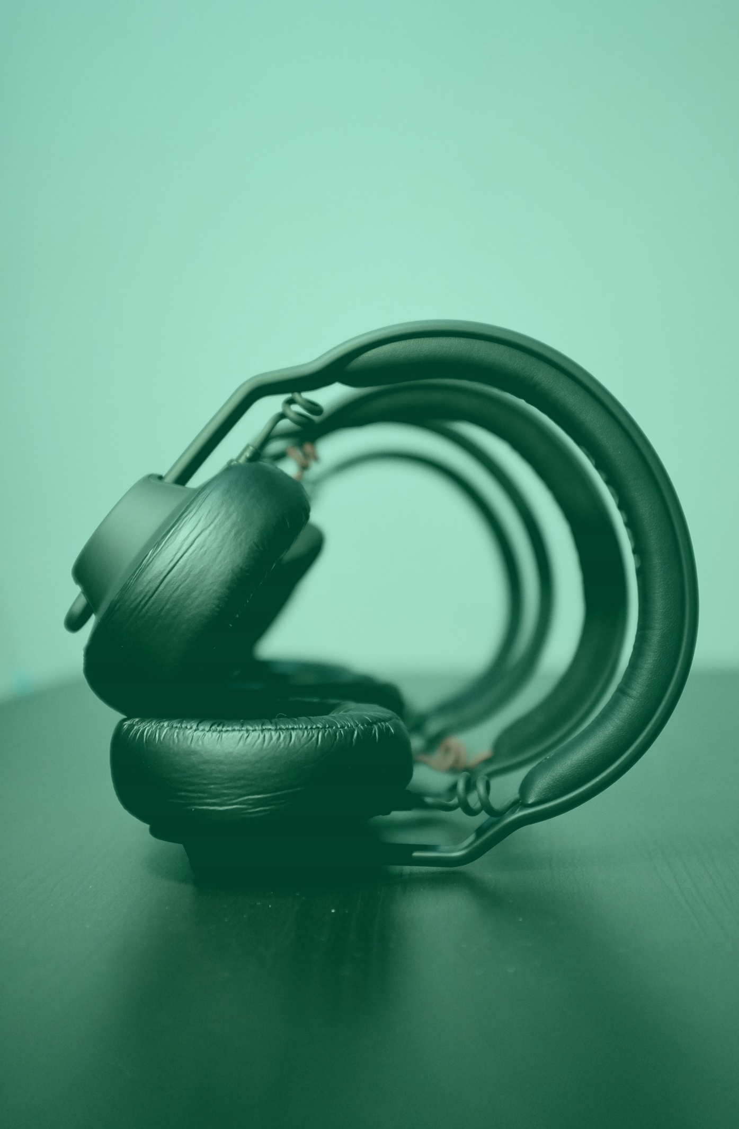
Talk directly to your customers
Thirty-seven percent of US adults over 12 are listening to at least one podcast per month.¹ This is an increase of 16% YOY.
39% of men and 36% of women 12 and older are monthly podcast listeners.¹
75% of Americans are familiar with podcasting, an increase of 10 M in one year.¹
65% of podcast listeners tune in on mobile devices like smart phones and tablets.²
“Approximately 169 million Americans listened to online audio in the last week, spending an average of over 15 hours doing so.”¹
¹http://www.edisonresearch.com/wp-content/uploads/2020/03/The-Infinite-Dial-2020-U.S.-Edison-Research.pdf
²https://www.oberlo.com/blog/podcast-statistics

Slide 3

Podcasts are good business
Demonstrate thought leadership in your industry
Put a human face (or voice) on your organization
Expand your reach exponentially through podcast channels
Highlight the expertise of your team
Showcase customer successes
Create an engaged community
Speak directly to potential customers
Build trust
Connect with complementary industry experts/companies to build mutually beneficial relationships

Slide 4

Podcasts are the ultimate “bingeable media,” offering your business the chance to be literally in your audience’s heads, educating, inspiring, and entertaining, for an hour or more at a time.

Slide 5

What you get with Puget Sounds
Depending on the packet/services you choose, here’s the process:
We meet with you and your marketing team to discuss your business goals for the podcast
Together, we’ll decide if a podcast is right for your business.
Next, we’ll meet with your content team to lay out a six-month plan of two podcasts/month, and we will…
  Identify Subject Matter Experts (SMEs) on your team
  Equip your SMEs to record
  Determine appropriate questions and script interviews
  Rehearse with and coach your SMEs
We’ll line up voice talent to conduct interviews
We’ll work with your graphics team to create cover and thumbnail art
Puget Sounds will scout the perfect music for your podcast, if needed
Our director and tech will be present for coaching and support during episode recordings
Our audio tech will produce and publish your episodes

Slide 6

Choose your learning curve (or none)
THE COMPLETE PODCAST PACKAGE
Podcast set up, content, and production
Hosting and publishing
Cover and thumbnail art (artist fees not included)
Distribution
Stats
Voice talent (artist fees not included)
Music
Show notes and episode transcripts
Optional extras include direction, social media posting, merchandising assistance, newsletter content, tech recommendations and support.
Total package: $2000 first month, $1800/month thereafter; $20,000 first year, if paid annually (equals one month free)
Our Complete Podcast Package is perfect if you know a podcast would be great for your business, but you don’t have time to create it yourself.
More of a DIYer? We get it. We also offer consultation and complementary services. Let us know what you’ll do — we’ll do the rest.

Slide 7
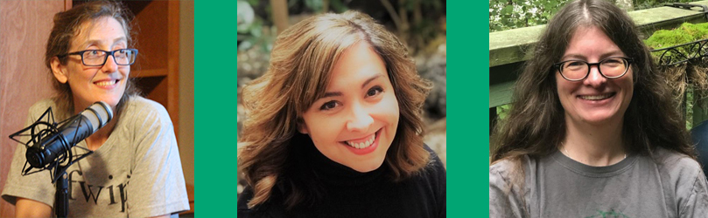
Your podcast team
Shannon Perry
Managing Director
With Masters’ in English Literature and Digital Media Communications, our Managing Director is our reigning Word Nerd. She will help develop scripts that keep your episodes smart and focused. With several years’ podcasting experience under her belt, Shannon also oversees production & publishing.
June Clark Eubanks
Creative Director
With and MFA in Directing, a background directing theater in Chicago, New York, and Miami, and a long and varied acting history, June knows how to pull the very best performance out of even the most reluctant and shy. She'll get your Subject Matter Experts "interview ready."
Heather McLaughlin
Administrative Director
Heather “backed into” accounting after many years of resistance, graduating from the Bookkeeping Certificate program at North Seattle College. She jumped at the chance to do something interesting with her newly minted degree. When not untangling artists' attempts to play with numbers, Heather can generally be found reading or running.

Slide 8

Schedule your free, 45-minute consultation
Website | Pugetsounds.com
Email | info@pugetsounds.com
Telephone | 206.235.1452
Twitter | @PugetSoundsLLC
Instagram | @pugetsoundspodcasting
Book me! | calendly.com/pugetsounds/free-consultation

